Slide 1



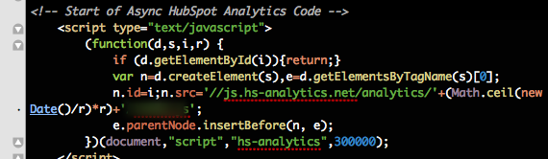
JavaScript Basics
Course Introduction
Svetlin Nakov
Technical Trainer
www.nakov.com
Software University
http://softuni.bg

Slide 2

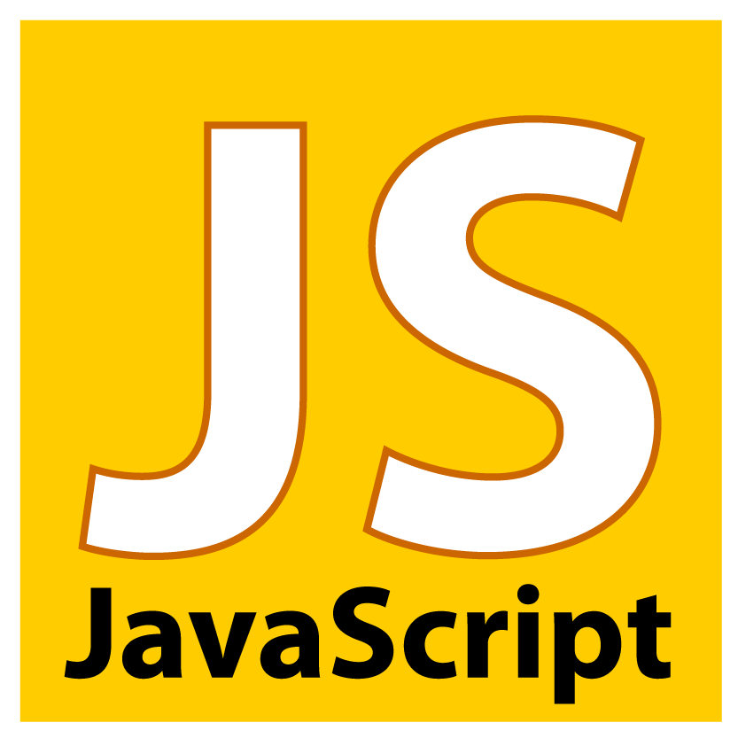
Table of Contents
Course Objectives
Course Program
Trainers Team
Examination
Learning Resources

Slide 3
Level #1 at the Software University
Java Basics
4 times + TW + exam
3 weeks * 2 times
Web Fundamentals (HTML + CSS)
10 times + TW + exam
6 weeks * 2 times
JavaScript Basics
5 times + TW + exam
4 weeks * 2 times
PHP Basics
4 times + TW + exam
3 weeks * 2 times
Teamwork and Personal Skills
8 times + team work project (TW)
16 weeks * 0.5 times

Slide 4

JavaScript Basics
Course Objectives & Program

Slide 5


JavaScript Basics – Course Program
Course Introduction – Course Program, Exams, Teachers, Evaluation, Resources JavaScript Introduction – Dynamic HTML, JS history, JS first steps, debugging JavaScript Tools/IDEs
JavaScript Syntax – Data types, variables, conditional statements…
Loops, Arrays and Strings
Functions and Objects – Function scope, creating and using objects
Working with DOM and Events – Create/Edit elements, basic event handling
Practical Exam
Teamwork Defense

Slide 6

Warning: Not for Absolute Beginners
The "JavaScript Basics" course is NOT for absolute beginners
Take the "C# Basics" course at SoftUni first: https://softuni.bg/courses/csharp-basics
The course is for beginners, but requires previous coding skills
Requirements
Coding skills – entry level
Computer English – entry level
Logical thinking
coding skills
required!

Slide 7

The Trainers Team

Slide 8
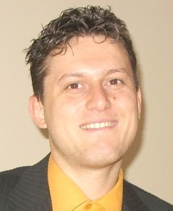
Trainers Team
Svetlin Nakov, PhD
Training & Inspiration Manager @ Software University
20+ years software development experience
10+ years experience as trainer
Author of 7 programming books
Speaker at hundreds of events
Web site & blog: www.nakov.com

Slide 9
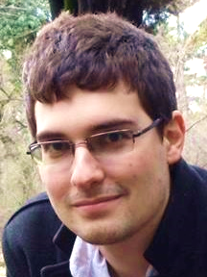

Trainers Team (2)
Teodor Kurtev
Software engineer @ Software University
Top performing graduate from the Software Academy (2013)
Vladimir Georgiev
Software engineer @ Software University
Top performing graduate from the Software Academy (2013)

Slide 10
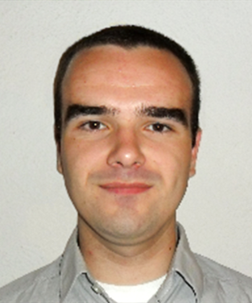

Trainers Team (2)
Vladislav Karamfilov
Game developer @ XS Software
Top performing graduate from the Software Academy (2013)
Volunteer Trainers
Top students from SoftUni
Will teach workshops and advanced topics

Slide 11
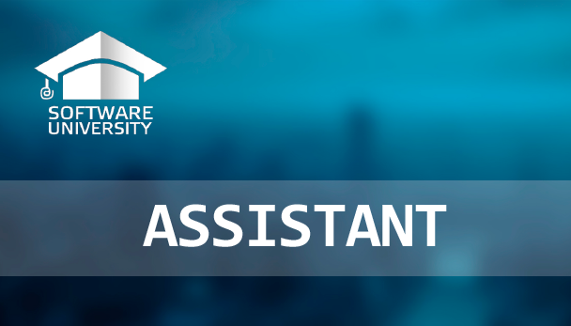
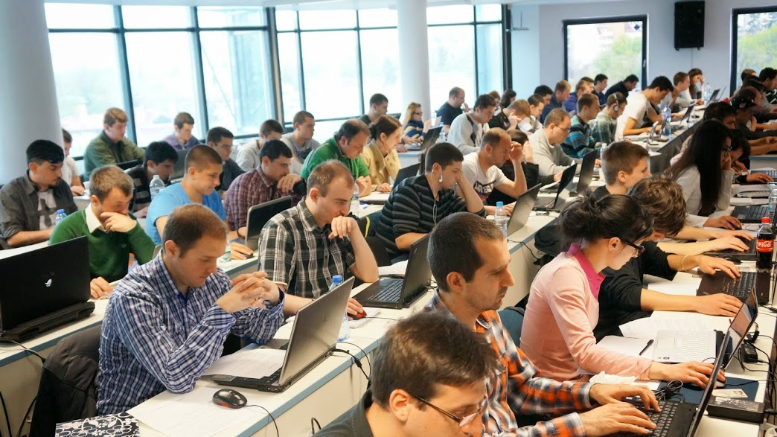
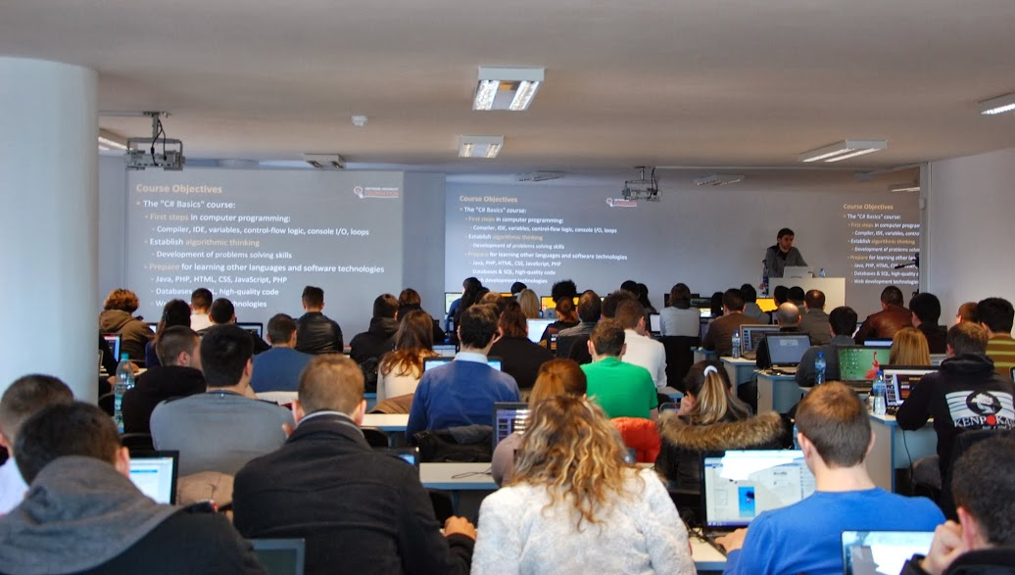
Volunteer Teaching Assistants
10+ volunteer teaching assistants
Developers from the software industry
Scholarship students from SoftUni

Slide 12

JavaScript Basics: More Details
Duration, Languages, Technologies

Slide 13


Training Duration – Web Fundamentals
Lectures: ~ 10 hours (onsite + YouTube videos)
Practical exercises (in class): ~ 10 hours
Homework: ~ 30-50 hours
Team project: ~ 10-20 hours
Exam preparation: 8 hours
Exam: 6 hours
Schedule: July 2014
Exam dates: ~ 27-29 July 2014
Teamwork defense dates: 30 July – 1 Aug 2014

Slide 14
Why JavaScript?
Runs both in front-end and back-end
Makes Web sites more dynamic and to build fast servers
Tons of job growth and high pay for those who know JavaScript
Node.js – 80 000% growth in demand over the last 3 years
Angular.js – 9 000% growth in demand in just last year
Open source
JS is defined as ECMAScript – free for anybody to implement
JavaScript is running everywhere: browsers, mobile phones, etc.

Slide 15



Why English?
Why the slides are in English?
English is the native language of the software engineers
Specific terminology should be in English
Translations are inaccurate and funny
Just learn English!
No excuses

Slide 16
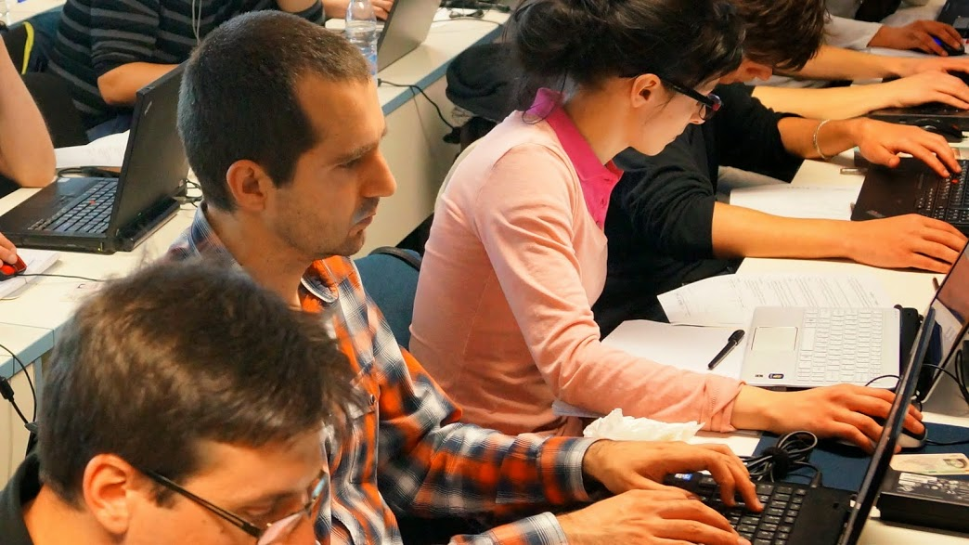


JavaScript Basics
Evaluation Criteria

Slide 17


Scoring System for the “JavaScript Basics”
Exam – 75% (80% for online students)
Homework + evaluation – 5% + 5%
Team work: 10%
Presence in class: 5% (onsite students only)
Bonuses: up to 10%
Assistant bonuses
Forum bonuses
Others

Slide 18
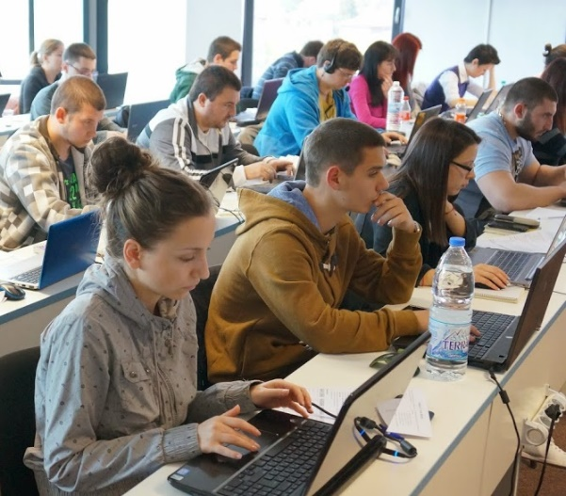

JavaScript Exam
Practical programming exam
4 practical problems for 5 hours
1 easy, 2 with loops, 1 with arrays / strings
You should code in JavaScript
Automated judge system with real-time feedback
http://judge.softuni.bg
Solutions are evaluated for correctness only
Code quality is still not measured

Slide 19

Homework Assignments
Doing your homework is very important!
Programming can only be learned through a lot of practice!
You should write code every day!
Each lecture is followed by a few exercises
Try to solve them in class
The rest are your homework
Homework assignments are due in 1-2 weeks after each lecture
Submission will be accepted through our web site: softuni.bg

Slide 20

Homework Peer Reviews
Give feedback to a few random homework submissions
Students submit homework anonymously
Please exclude your name from the submissions!
For each homework submitted
Students evaluate 3 random homeworks
From the same topic, after the deadline
Give written feedback, at least 200 characters
Low-quality feedback → report for punishment
Everyone will get feedback for their homework

Slide 21





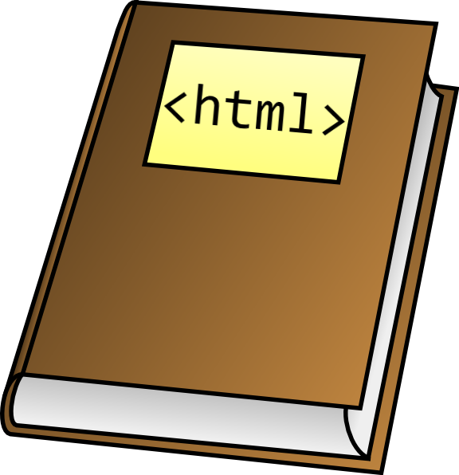



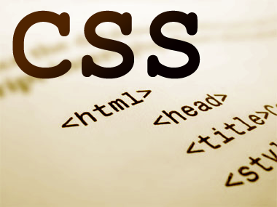
Resources
What We Need Additionally?

Slide 22

Course Web Site & Forums
The Web Fundamentals official web site:
Register for the "Software University Forum":
Discuss the course exercises with your colleagues
Find solutions for all course exercises
Share source code / discuss ideas / help each other
https://softuni.bg/trainings/coursesinstances/details/4
https://softuni.bg/forum

Slide 23



JavaScript Basics Slides and Videos
All lecture slides, videos, homework assignments, projects and other resources are open content, available for free
Visit the course web site to access the course resources

Slide 24


JavaScript Resources
Mozilla Development Network (MDN)
https://developer.mozilla.org
Web Platform
http://www.webplatform.org
JavaScript Books
JavaScript: The Definitive Guide
JavaScript: The Good Parts

Slide 25
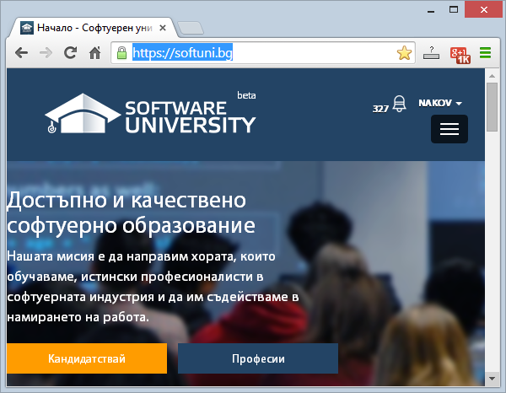
Software University Learning System (SULS)
Software University Learning System (SULS)
www.softuni.bg
Important resource for students
Homework submissions
Homework check-up
Exams and results
Reports about your progress
…

Slide 26


Recommended Software
Microsoft Visual Studio 2013 or Visual Studio Express 2013
WebStorm
Sublime Text
Komodo IDE

Slide 27


Summary
The “JavaScript Basics" course teaches
The first steps in JavaScript
Training program
Data types and variables, conditional statements, loops, arrays, using objects, DOM, events
Practical exam
Form image to JavaScript Basics + score system
Learning resources
Lectures, videos, software, books, forum
JS Basics

Slide 28







JavaScript Basics – Course Introduction
https://softuni.bg/courses/javascript-basics

Slide 29
License
This course (slides, examples, demos, videos, homework, etc.) is licensed under the "Creative Commons Attribution-NonCommercial-ShareAlike 4.0 International" license
Attribution: this work may contain portions from
“JavaScript Basics" course by Telerik Academy under CC-BY-NC-SA license

Slide 30




Free Trainings @ Software University
Software University Foundation – softuni.org
Software University – High-Quality Education, Profession and Job for Software Developers
softuni.bg
Software University @ Facebook
facebook.com/SoftwareUniversity
Software University @ YouTube
youtube.com/SoftwareUniversity
Software University Forums – forum.softuni.bg

